Slide 1
Hotel Booking Analysis
Exploring booking patterns, cancellations, and customer behavioral segmentation.

Slide 2
Project Objective Overview
Primary Goal:
Analyze a hotel dataset to optimize operations, increase revenue, and enhance guest satisfaction.
Key Focus Areas:
Booking Patterns: Understand trends in guest bookings, including peak periods, booking lead times, and channels.
Customer Behavioral Segmentation: Identify different customer segments based on behaviors and preferences to tailor services and marketing.
Operational Efficiency: Evaluate current operations to identify inefficiencies and areas for improvement.
Revenue Management: Analyze pricing strategies and revenue streams to maximize profitability.
Loyalty Programs & Repeat Business: Assess the effectiveness of loyalty programs and understand factors driving repeat bookings.
Sprint Objective:
Data Cleaning: Ensure the dataset is free from errors, inconsistencies, and missing values.
Data Analysis: Focus on key areas including booking patterns, cancellations, customer segmentation, and operational performance.
Insight Generation: Summarize key findings to guide strategic decisions in the hotel’s operations and marketing.

Slide 3
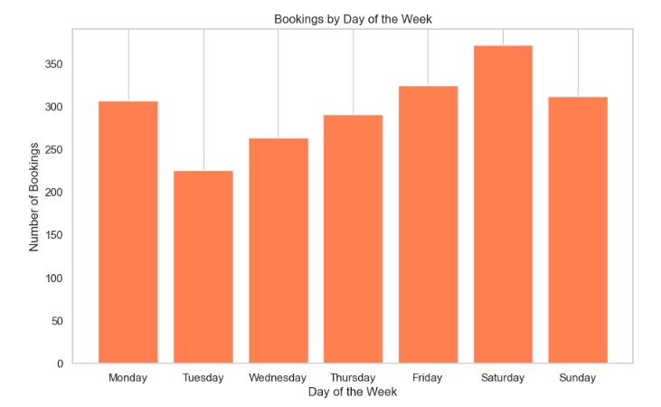
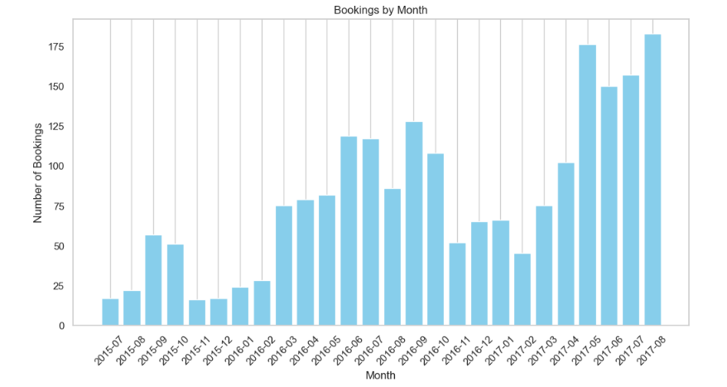
Booking Pattern Analysis
Section Break
Insert the Sub Title of Your Presentation
There is an upward trend in bookings over the 14-month period shown, with the highest number of bookings occurring in AUG 2017. The day of the week with the highest number of bookings is Saturday, and the day with the lowest number of bookings is Monday.

Slide 4
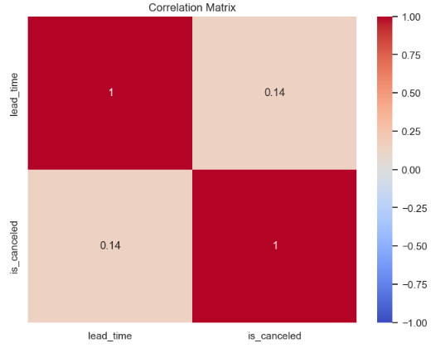
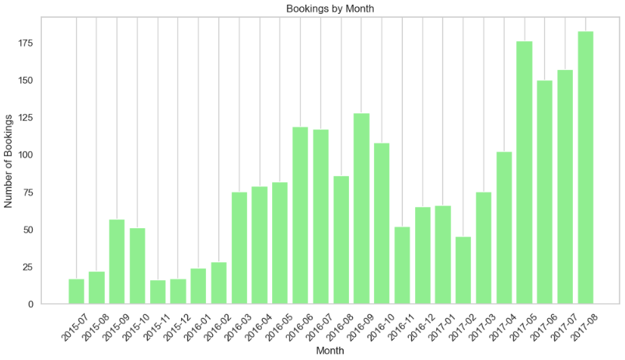
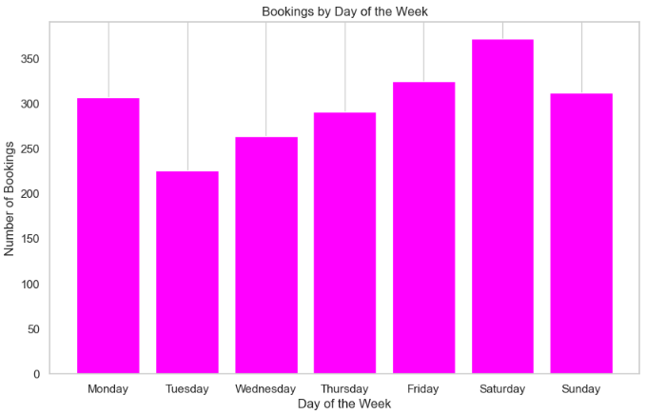
Peak on Saturday: Upward Trend: There's a general upward trend in bookings from 2015-07 to 2017-08.Peak in 2017-08: The highest number of bookings occurs in August 2017.Lowest in 2015-07: The lowest number of bookings occurs in July 2015.The highest number of bookings occurs on Saturday.Lowest on Tuesday: The lowest number of bookings occurs on Tuesday.

Slide 5
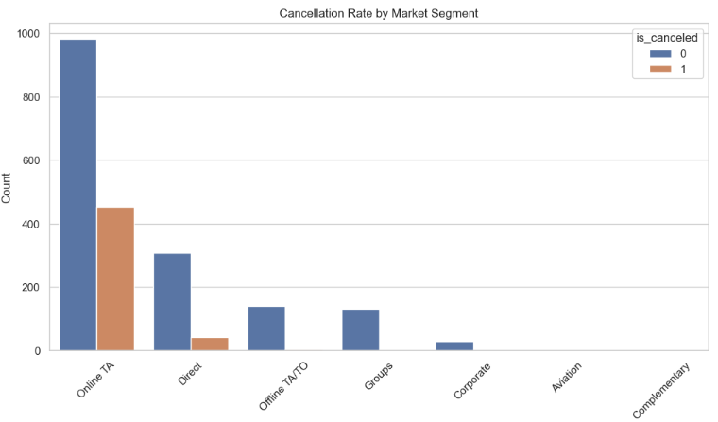
Booking Cancellation Analysis
Name Here
Online TA Market Segment Contributes Most Booking. But unfortunetly it also leads to Booking Cancellations.

Slide 6
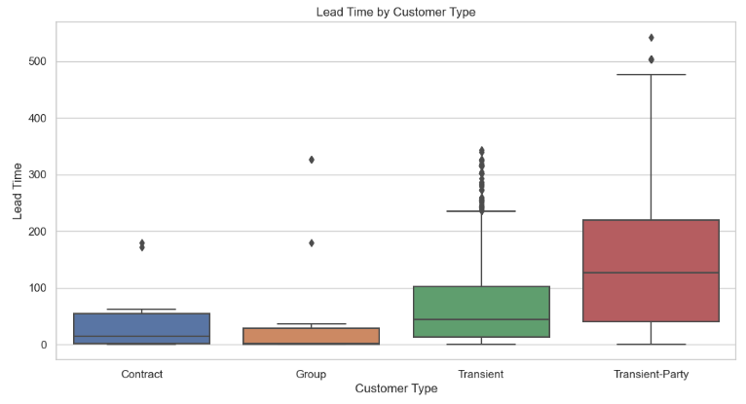
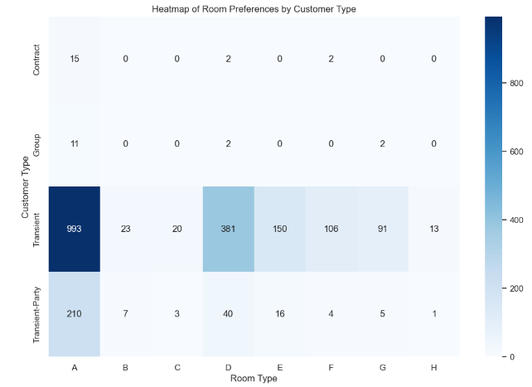
Customer Behavioral Segmentation
Room Type A: Highly popular among Transient-Party customers.
Room Types C and D: Versatile options preferred by multiple customer types.
Room Types E, F, G, and H: Less popular choices across all customer types.
Name Here

Slide 7
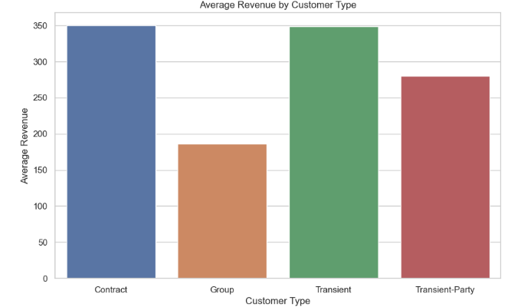
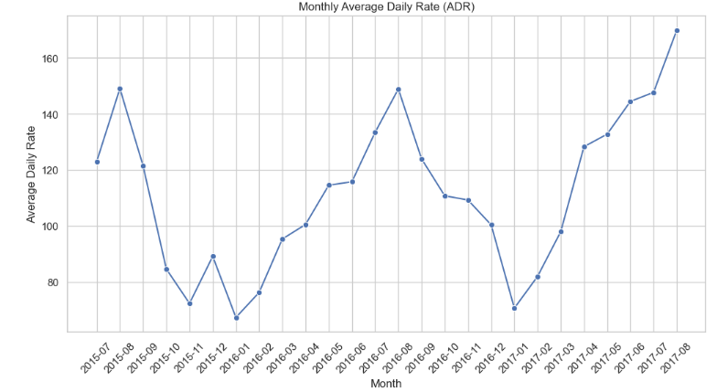
Revenue Management
Highest Average Revenue: Transient customers generate the highest average revenue.Lowest Average Revenue: Group customers generate the lowest average revenue.
Revenue Gap: There's a significant difference in average revenue between Transient and Group customers.
Name Here

Slide 8
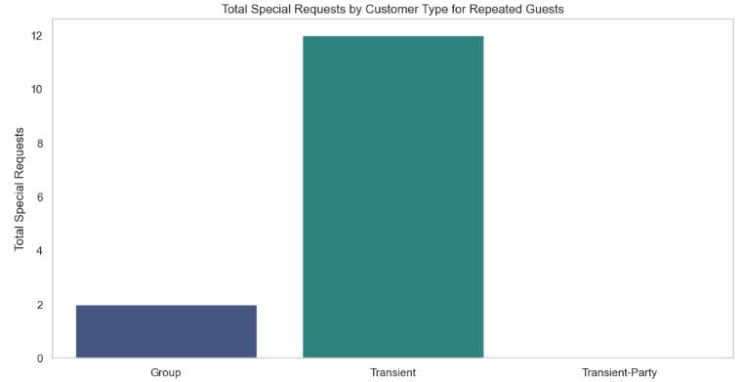
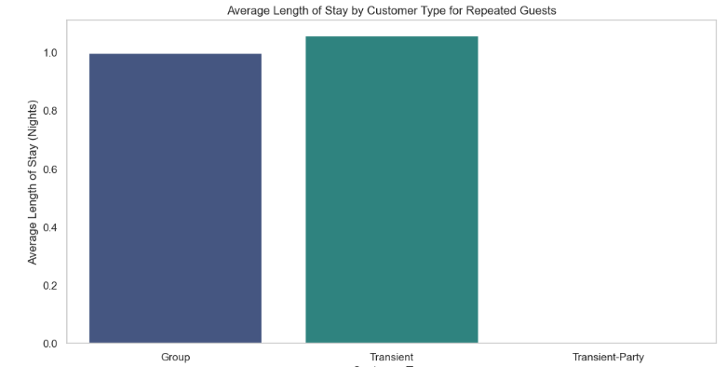
Loyalty Programs and Repeat Business
The data suggests that focusing on attracting more Group customers could potentially increase revenue due to their higher ADR and longer stays.Transient-Party customers have the highest number of total special requests.he higher number of special requests from Transient-Party customers might require additional resources or tailored service offerings.
Name Here

Slide 9
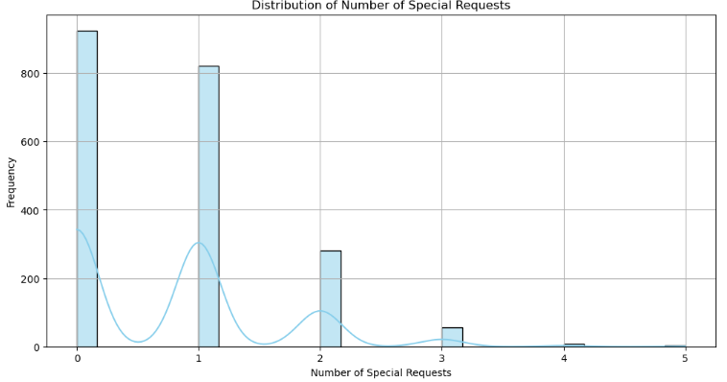
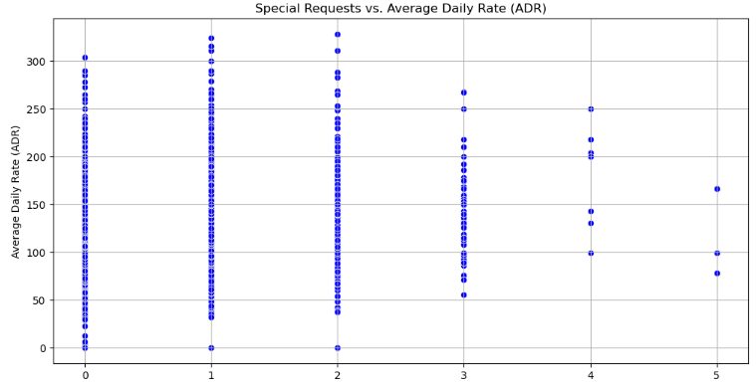
Customer Satisfaction
The Pearson correlation coefficient of 0.1147 confirms the weak positive relationship between the two variables.There seems to be a weak positive relationship between the number of special requests and the average daily rate (ADR). This means that as the number of special requests increases, there's a slight tendency for the ADR to increase as well.

Slide 10
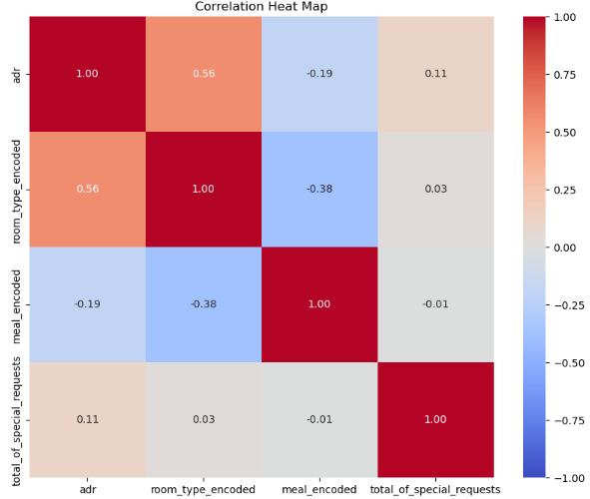
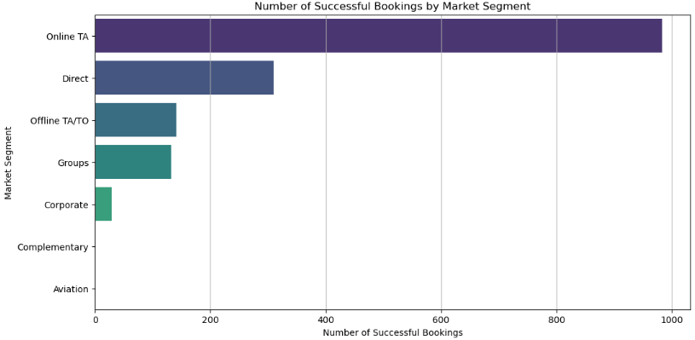
Marketing and Sales Optimization
Strong positive correlation: adr and room_type_encoded have a strong positive correlation (0.56). This means that as the room_type_encoded increases, the adr also tends to increase.Moderate positive correlation: meal_encoded and room_type_encoded have a moderate positive correlation (0.38). This means that as the meal_encoded increases, the room_type_encoded also tends to increase.
Name Here

Slide 11
Business Conclusion
The Hotel Booking Data Analysis reveals key opportunities to improve hotel operations and boost revenue:
Booking Patterns:
Bookings peak in August and on Saturdays, indicating the need for targeted promotions and dynamic pricing during these high-demand times.
Cancellations:
There’s a weak link between lead time and cancellations, and a moderate connection between special requests and cancellations. Tailored cancellation policies and incentives could help reduce cancellations, especially during busy periods.
Booking Channels:
The "Online TA" segment is the largest contributor to bookings and revenue, so focusing marketing efforts here is crucial. High-value customer segments like "Transient" and "Transient-Party" guests should be prioritized, along with promoting popular room types like Room Type A.
Revenue Management:
Room Type H has the highest rates, suggesting that pricing strategies based on room type and amenities can increase revenue.
Operational Efficiency:
Aligning staffing and resources with booking patterns and special requests will improve efficiency. To protect revenue, policies that limit booking changes should be considered, especially since revenue drops significantly after four changes.
Loyalty Programs and Customer Feedback:
Strengthening loyalty programs and refining services based on customer feedback will boost satisfaction and encourage repeat business.

